Slide 1

Bignum Calculator
by Joseph Pollack

Slide 2
Source
library repo:
github.com/eindacor/JEPbignum
calculator repo:
github.com/eindacor/JEPbignum_calculator
library docs:
github.com/eindacor/JEPbignum/blob/master/README.md

Slide 3
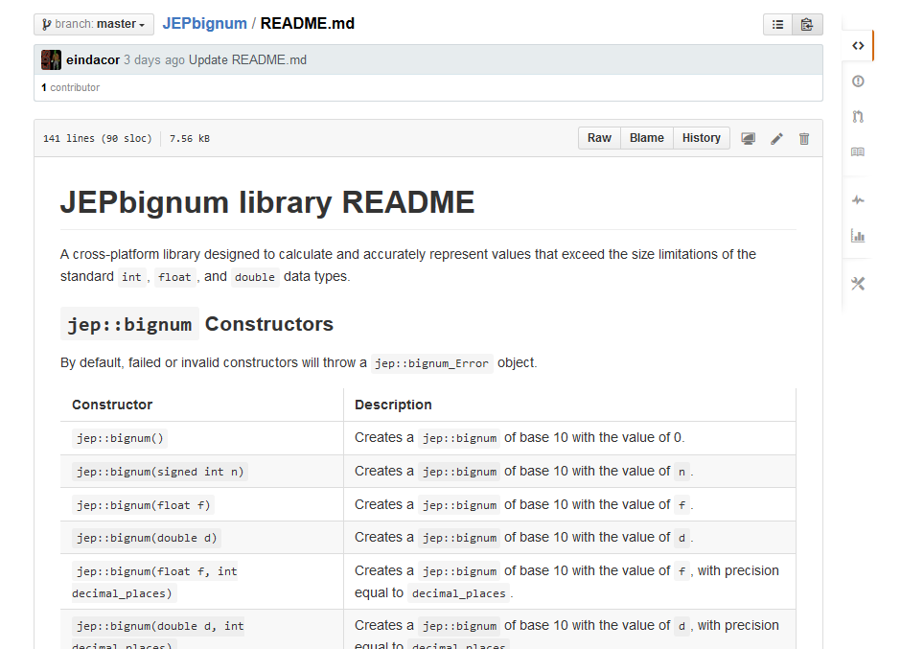
Documentation

Slide 4
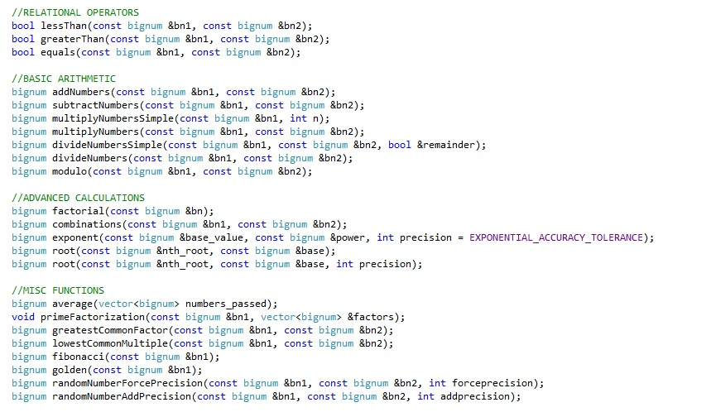
Methods

Slide 5
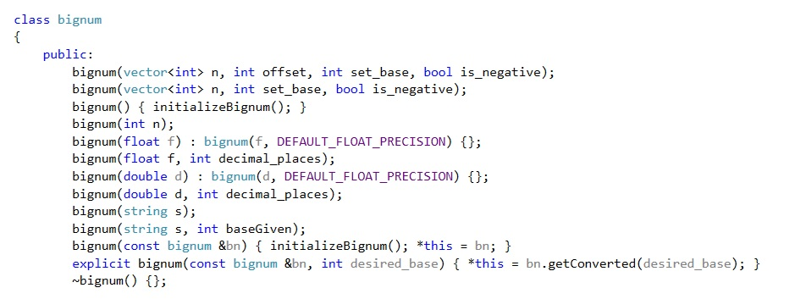
Constructors

Slide 6
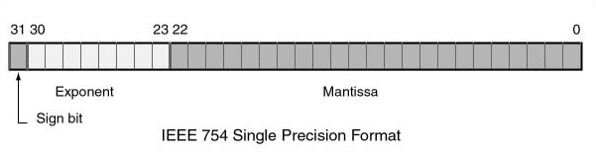
Floating Point Representation
In code: 1.25
In binary: (1.01 * (10 ^ 0))
In memory: 0 01111111 01000000000000000000000
Sign: 0
Exponent: 01111111 (127)
Mantissa: 01000000000000000000000

Slide 7
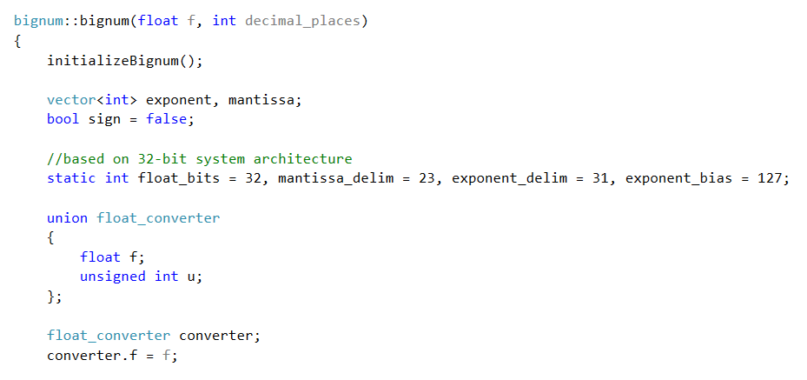
Float Constructor

Slide 8
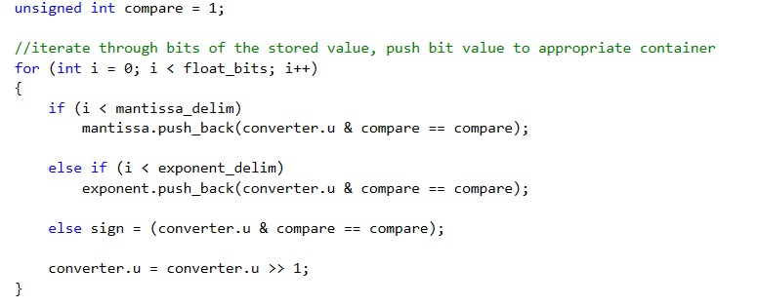
Float Constructor

Slide 9
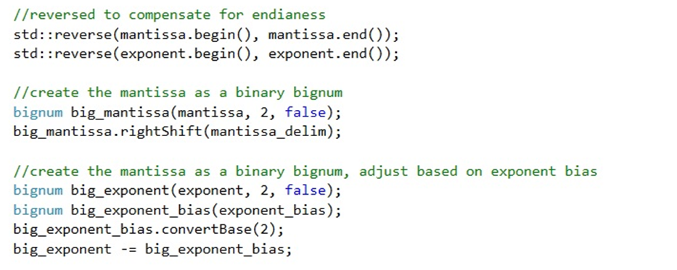
Float Constructor

Slide 10
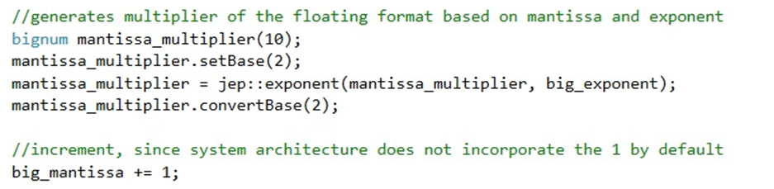
Float Constructor

Slide 11
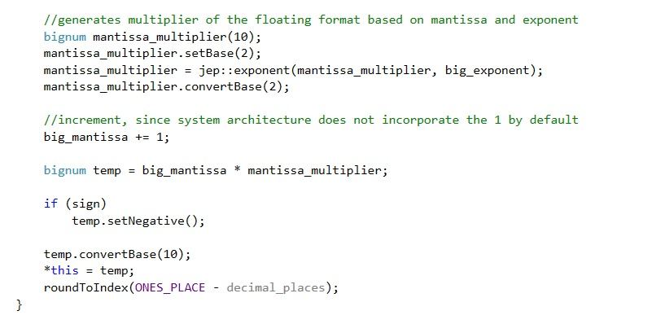
Float Constructor

Slide 12
Source
library repo:
github.com/eindacor/JEPbignum
calculator repo:
github.com/eindacor/JEPbignum_calculator
library docs:
github.com/eindacor/JEPbignum/blob/master/README.md

Slide 13
Bignum Calculator
by Joseph Pollack

Slide 14
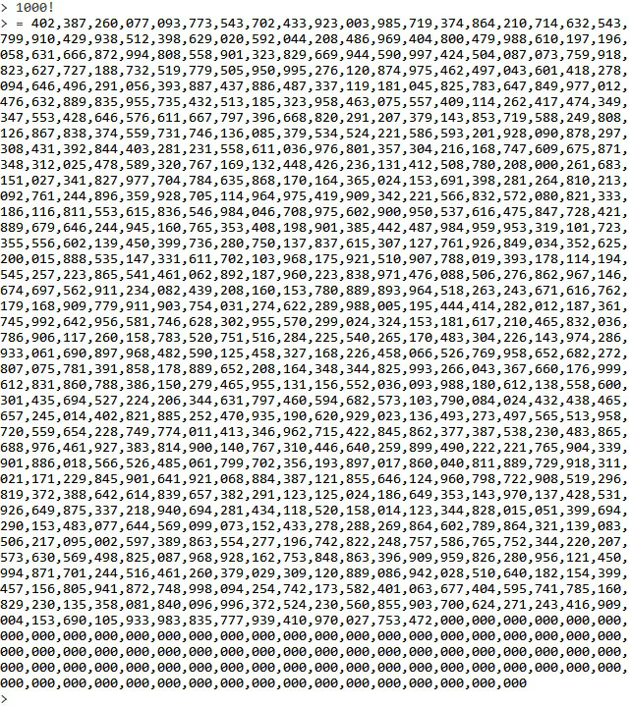
Bignum Calculator

